Slide 1
What is Git ?
1
Presentation of the advantages to use git and some basics terminal commands.

Slide 2
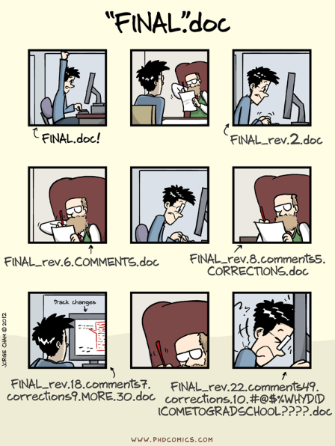
Because we don’t want that anymore
2

Slide 3
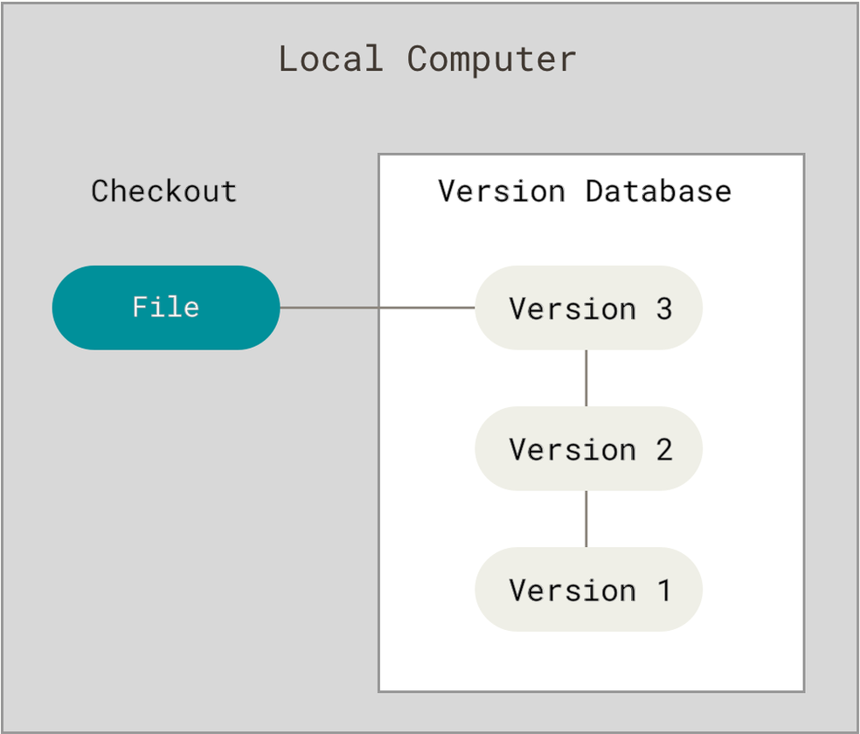
A word on system versioning:
Solo versioning
3
When you are working on a file, alone, you will usually use this kind of system versioning
But what happens when you are not alone anymore ?

Slide 4
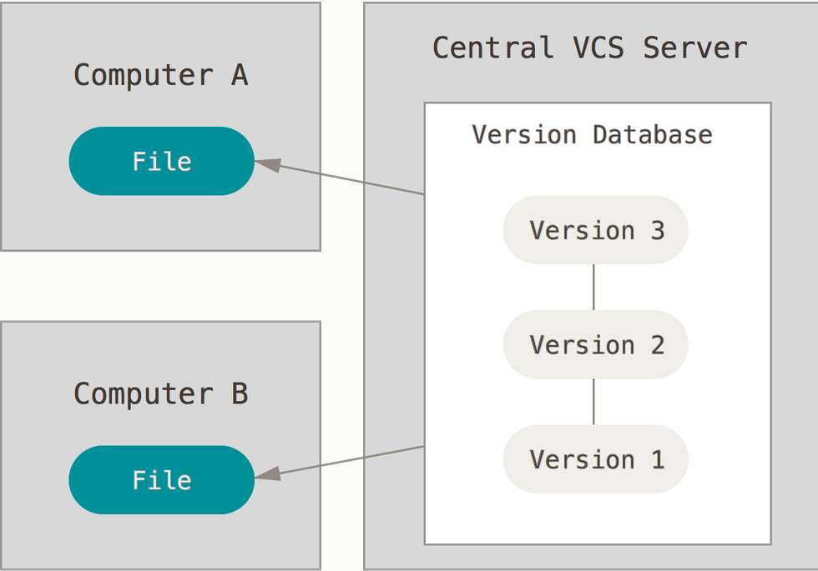
Centralized Version control system
4
A common and easy way to do this is to have a share database and each change from someone will be a new version

Slide 5
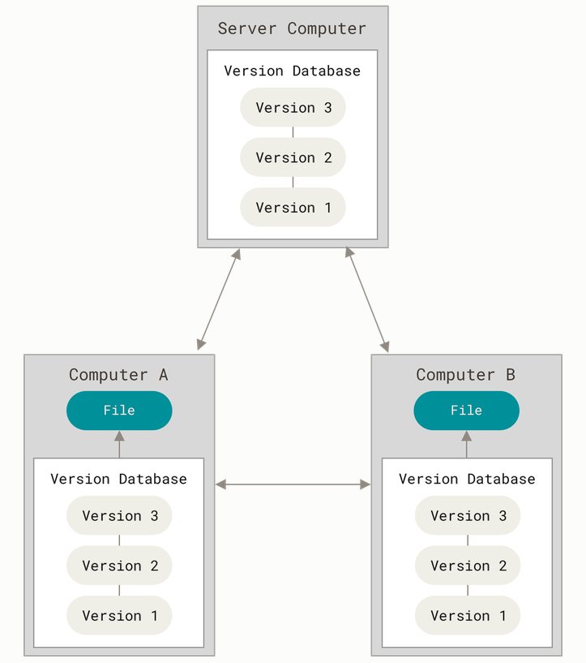
Distributed version control
5
But to have a lower risk to lose your data and be able to work even you don’t have access to the server we can have all a copy of the version database.

Slide 6
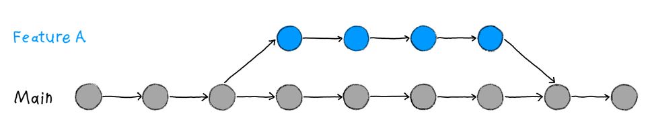
Branching, or when version1.bis begin
6
Sometimes we want to change something, but first when we are working on it, this new version will maybe not work anymore and secondly maybe you are not sure that you will keep this feature
So, the natural way is to make a copy of the last version, call it differently and work on this new file.
This is called branching

Slide 7
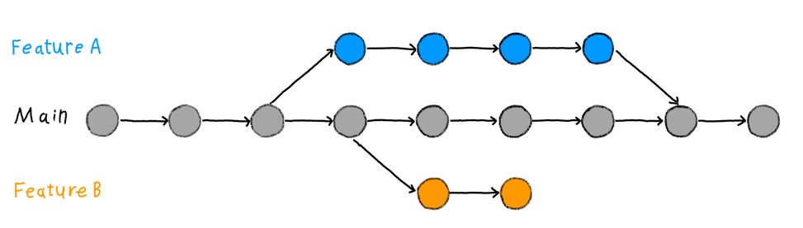
Particularly useful when you want to work at the same time with two different features, or two different people.
7

Slide 8
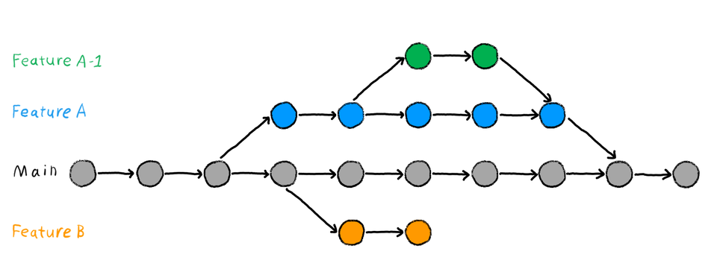
And maybe go crazy ?
8

Slide 9

9
In 2005 the Linux development community (and in particular Linus Torvalds, the creator of Linux) developed their own open source tool: Git.
Some of the goals of the new system were as follows:
Speed
Simple design
Strong support for non-linear
development (branches)
Fully distributed
Able to handle large projects

Slide 10

Some useful terminal commands
Git can be used entirely or partially through a text editor such as VSCode, RStudio, or Vim, but this can be limiting. Learning the CLI (command line interface) helps you truly understand what you're doing, and that understanding carries over to any text editor you use.
For that we will need 3 basics commands in your terminal.
10

Slide 11
When you open your terminal, you arrive at your root directory, to move inside you will need to:
see where you are: pwd for print working directory
see where you can go: ls for list
Move: cd [directory] for change directory
ls –force for windows or ls –la for linux/mac to see hidden files
cd .. to go back
cd ~ to go back to your root directory
11

Slide 12
Questions and next part
12

